Slide 1
Business Intelligence

Slide 2
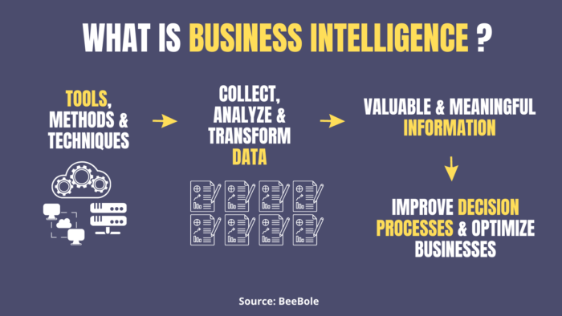
definition
Business intelligence is the process by which enterprises use strategies and technologies for analyzing current and historical data, with the objective of improving strategic decision-making and providing a competitive advantage.
Business intelligence environments consist of a variety of technologies, applications, processes, strategies, products, and technical architectures used to enable the collection, analysis, presentation, and dissemination of internal and external business information.

Slide 3
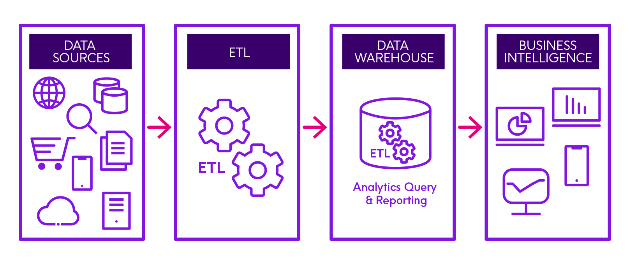
data integration
Data integration is an important part of any data technology solution. Data integration enables you to easily access all of the data you need to make informed business decisions and allows you to transform and combine data sources for accurate analysis.

Slide 4
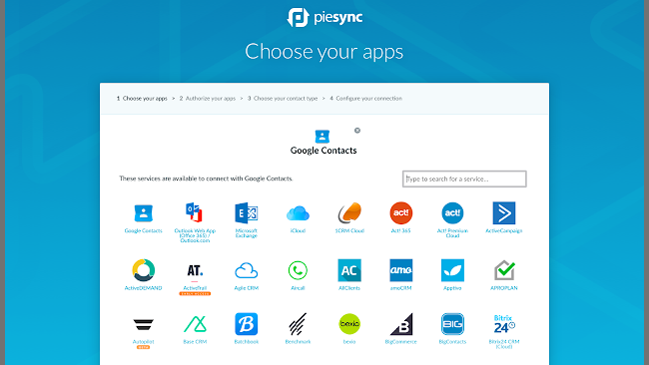
examples
PieSync is a great data integration tool for those looking to sync their contacts with other applications. How it works is PieSync works in the background, syncing your contacts in real-time with all your favorite marketing apps. Some popular tools you can connect with include MailChimp, Hubspot, Nimble, Salesforce and more.

